Slide 1


LIFECYCLE OF BRANDING
Strategizing for a Unified and Recognizable Identity
Presented By : Xinyue (Iris) Wang

Slide 2
BRAND
BRAND PERSONALITY
COMMUNICATIONS PLAN
BRAND DNA
POSITIONING
Notes:
I’ve prepared a few slides to outline the lifecycle of branding from a high-level perspective, drawing from my marketing experience. If you have a few minutes, I’d love to walk you through them.
Branding is the process of defining how we want to be perceived and shaping that perception in the minds of others. A strong brand offers numerous benefits, such as enhancing recognition, building credibility, and fostering long-term relationships. There are four pillars of branding: Brand DNA, Positioning, Personality, and the Communications Plan. These elements guide the journey from defining who we want to be to how we present.

Slide 3
BRAND DNA
Audience
Mission and Vision
Values
Promises
Notes:
Brand DNA is the foundation of who we are. It starts with a deep understanding of our audience, which informs our mission, vision, values, and promises. These elements should permeate every aspect of daily operations, ensuring alignment across the organization. For instance, many successful companies use live dashboards displaying key metrics visible to all staff, reinforcing shared goals and promises. Maintaining organizational alignment may sound straightforward, but it’s one of the most challenging—and vital—parts of building a cohesive brand.

Slide 4
POSITIONING
Competitor Analysis
Positioning
Differentiation
Notes:
Positioning helps us establish how we differentiate ourselves in the marketplace. This requires thorough competitor analysis—both internal and external—to identify our unique strengths. With this insight, we can position our brand effectively on a perceptual map and develop a clear and compelling positioning statement. This serves as the backbone for building a consistent and unified brand presence.

Slide 5
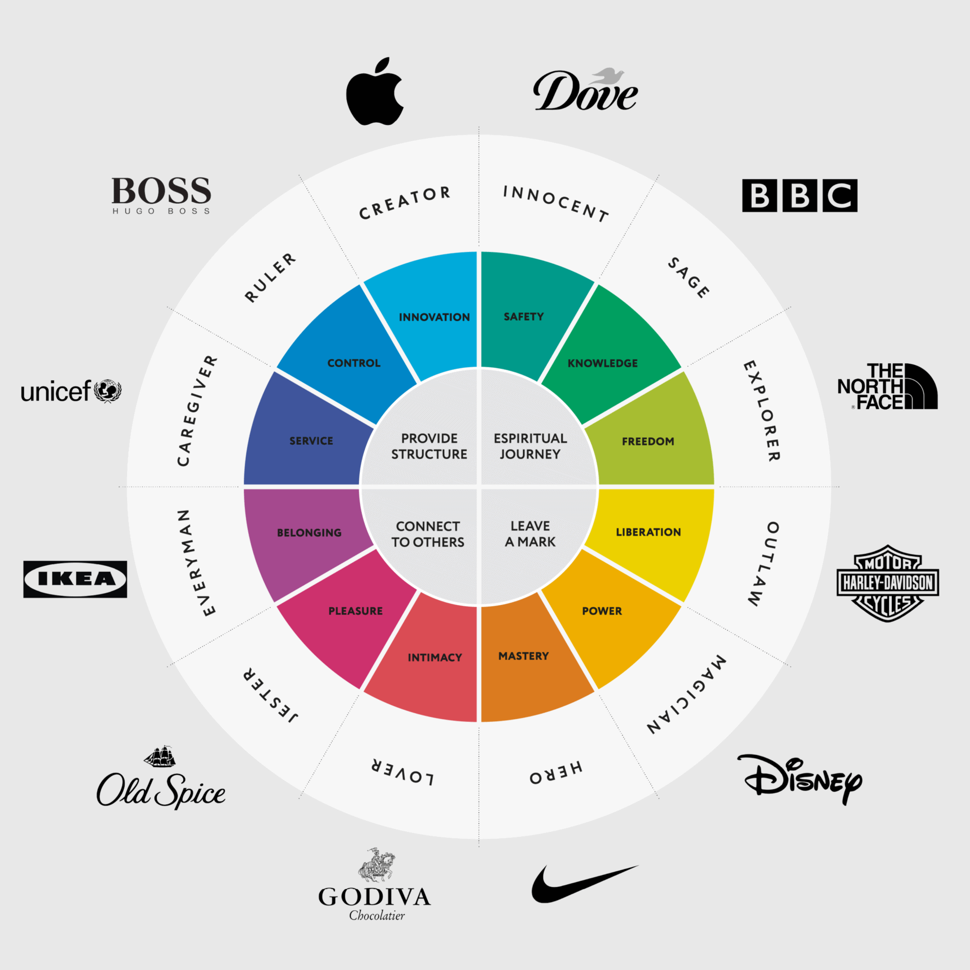


BRAND PERSONALITY
Verbal
Identity
Visual
Identity
Tone
Messaging and storytelling
Logo
Colour Palatte
Typography
Slogan
[all going into a branding kit]
Notes:
Once we’ve defined who we want to be, we craft the brand personality—how we show up in the world. This includes both verbal identity (our tone and voice) and visual identity (design and imagery). Together, these elements help us define our brand archetype. For example, do we want to be seen as a nurturing and dependable caregiver? Or perhaps something entirely different? This step humanizes the brand and makes it relatable to our audience.

Slide 6
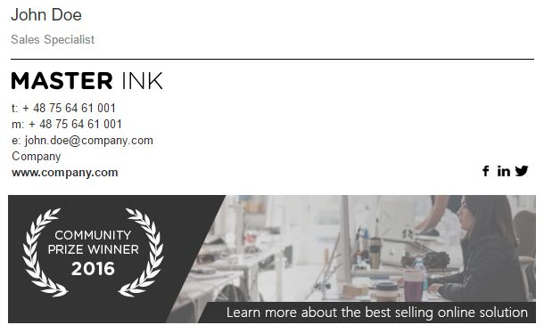
COMMUNICATIONS PLAN
INTERNAL
EXTERNAL
Digital
Email Newsletter
Email Signature Banner
SPO Banner
Others
  Bulletin Board Poster
  Announcements
  Orientation Materials
Digital
Email Signature Banner
Notes:
Finally, the communications plan determines how we present ourselves. This plan is tailored to reflect the brand’s DNA, positioning, and personality, ensuring a consistent message across all touchpoints. For instance, something as simple as an email signature banner can reinforce brand identity when aligned with our broader strategy.
All in all, branding is an ongoing journey that requires alignment, differentiation, and thoughtful execution. These four pillars—Brand DNA, Positioning, Personality, and Communications—lay the groundwork for creating a brand that resonates with our audience and stands the test of time.

Slide 7
THANK
YOU
Presented By : Xinyue (Iris) Wang
Notes:
This concludes my presentation. Thank you for your time!
In the case if some of these services that I mentioned are unavailable in your university,
you can always search online for external resources and support. The key is don’t be
afraid to reach out, and become a problem solver.
I hope you now feel more prepared to navigate your first year of university.
Remember to stay informed, plan ahead, and make the most of your university resources.
If you have any questions, feel free to ask. Best of luck on your journey—be resilient,
stay well, and get involved!

